Slide 1
Machine-Level Representation of Programs I

Slide 2
Outline
Memory and Registers
Data move instructions
Suggested reading
  Chap 3.1, 3.2, 3.3, 3.4

Slide 3
Characteristics of the high level programming languages
Abstraction
  Productive
  reliable
Type checking
As efficient as hand written code
Can be compiled and executed on a number of different machines

Slide 4
Characteristics of the assembly programming languages
Managing memory
Low level instructions to carry out the computation
Highly machine specific

Slide 5
Why should we understand the assembly code
Understand the optimization capabilities of the compiler
Analyze the underlying inefficiencies in the code
Sometimes the run-time behavior of a program is needed

Slide 6
From writing assembly code to understand assembly code
Different set of skills
  Transformations
  Relation between source code and assembly code
Reverse engineering
  Trying to understand the process by which a system was created
    By studying the system and
    By working backward

Slide 7
Understanding how compilation systems works
Optimizing Program Performance
Understanding link-time error
Avoid Security hole
  Buffer Overflow

Slide 8
C constructs
Variable
  Different data types can be declared
Operation
  Arithmetic expression evaluation
control
  Loops
  Procedure calls and returns

Slide 9
Code Examples
C code int accum = 0; int sum(int x, int y) { int t = x+y; accum += t; return t; }

Slide 10
Code Examples
C code int accum = 0; int sum(int x, int y) { int t = x+y; accum += t; return t; } | _sum: pushl %ebp movl %esp,%ebp movl 12(%ebp),%eax addl 8(%ebp),%eax addl %eax, accum movl %ebp,%esp popl %ebp ret
Obtain with command gcc –O2 -S code.c Assembly file code.s

Slide 11
A Historical Perspective
Long evolutionary development
  Started from rather primitive 16-bit processors
  Added more features
    Take the advantage of the technology improvements
    Satisfy the demands for higher performance and for supporting more advanced operating systems
  Laden with features providing backward compatibility that are obsolete

Slide 12
X86 family
8086(1978, 29K)
  The heart of the IBM PC & DOS (8088)
  16-bit, 1M bytes addressable, 640K for users
  x87 for floating pointing
80286(1982, 134K)
  More (now obsolete) addressing modes
  Basis of the IBM PC-AT & Windows
i386(1985, 275K)
  32 bits architecture, flat addressing model
  Support a Unix operating system

Slide 13
X86 family
I486(1989, 1.9M)
  Integrated the floating-point unit onto the processor chip
Pentium(1993, 3.1M)
  Improved performance, added minor extensions
PentiumPro(1995, 5.5M)
  P6 microarchitecture
  Conditional mov
Pentium II(1997, 7M)
  Continuation of the P6

Slide 14
X86 family
Pentium III(1999, 8.2M)
  New class of instructions for manipulating vectors of floating-point numbers(SSE, Stream SIMD Extension)
  Later to 24M due to the incorporation of the level-2 cache
Pentium 4(2001, 42M)
  Netburst microarchitecture with high clock rate but high power consumption
  SSE2 instructions, new data types (eg. Double precision)

Slide 15
X86 family
Pentium 4E: (2004, 125Mtransistors).
  Added hyperthreading
    run two programs simultaneously on a single processor
  EM64T, 64-bit extension to IA32
    First developed by Advanced Micro Devices (AMD)
    x86-64
Core 2: (2006, 291Mtransistors)
  back to a microarchitecture similar to P6
  multi-core (multiple processors a single chip)
  Did not support hyperthreading

Slide 16
X86 family
Core i7: (2008, 781 M transistors).
  Incorporated both hyperthreading and multi-core
  the initial version supporting two executing programs on each core
Core i7: (2011.11, 2.27B transistors)
  6 cores on each chip
  3.3G
  6*256 KB (L2), 15M (L3)

Slide 17
X86 family
Advanced Micro Devices (AMD)
  At beginning,
    lagged just behind Intel in technology,
    produced less expensive and lower performance processors
In 1999
  First broke the 1-gigahertz clock-speed barrier
In 2002
  Introduced x86-64
  The widely adopted 64-bit extension to IA32

Slide 18
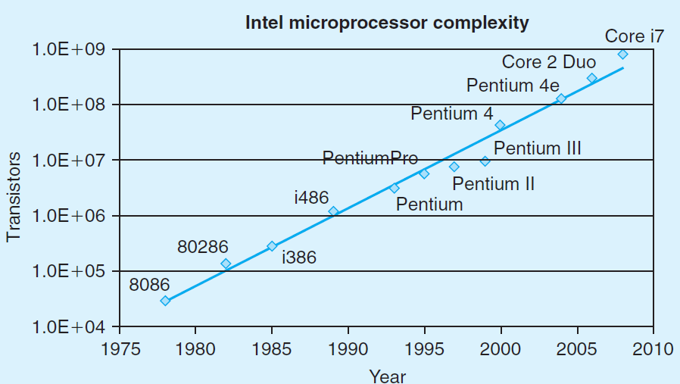
Moor’s Law

Slide 19
C Code
Add two signed integers
int t = x+y;

Slide 20
Assembly Code
Operands:
  x: Register %eax
  y: Memory M[%ebp+8]
  t: Register %eax
Instruction
  addl 8(%ebp),%eax
  Add 2 4-byte integers
  Similar to expression x +=y

Slide 21
Assembly Programmer’s View
FF
%eax
%ah
%al
Addresses
%edx
%dh
%dl
%ecx
C0
%ch
%cl
BF
Stack
%ebx
Data
%bh
%bl
%esi
80
Heap
%edi
Instructions
7F
%esp
%ebp
40
DLLs
%eip
3F
Heap
%eflag
Data
08
Text
00

Slide 22
Programmer-Visible States
Program Counter(%eip)
  Address of the next instruction
Register File
  Heavily used program data
  Integer and floating-point

Slide 23
Programmer-Visible States
Conditional code register
  Hold status information about the most recently executed instruction
  Implement conditional changes in the control flow

Slide 24
Operands
In high level languages
  Either constants
  Or variable
Example
  A = A + 4
variable
constant

Slide 25
Where are the variables? — registers & Memory
FF
%eax
%ah
%al
Addresses
%edx
%dh
%dl
%ecx
C0
%ch
%cl
BF
Stack
%ebx
Data
%bh
%bl
%esi
80
Heap
%edi
Instructions
7F
%esp
%ebp
40
DLLs
%eip
3F
Heap
%eflag
Data
08
Text
00

Slide 26
Operands
Counterparts in assembly languages
  Immediate ( constant )
  Register ( variable )
  Memory ( variable )
Example
  movl 8(%ebp), %eax
  addl $4, %eax
memory
register
immediate

Slide 27
Simple Addressing Mode
Immediate
  represents a constant
  The format is $imm ($4, $0xffffffff)
Registers
  The fastest storage units in computer systems
  Typically 32-bit long
  Register mode E_{a}
    The value stored in the register
    Noted as R[E_{a}]

Slide 28
Virtual spaces
A linear array of bytes
  each with its own unique address (array index) starting at zero
0xffffffff
0xfffffffe
0x2
0x1
0x0
… … … …
contents
addresses

Slide 29
Memory References
The name of the array is annotated as M
If addr is a memory address
M[addr] is the content of the memory starting at addr
addr is used as an array index
How many bytes are there in M[addr]?
  It depends on the context

Slide 30
Indexed Addressing Mode
An expression for
  a memory address (or an array index)
Most general form
  Imm(E_{b}, E_{i}, s)
  Constant “displacement” Imm: 1, 2 or 4 bytes
  Base register E_{b}: Any of 8 integer registers
  Index register E_{i} : Any, except for %esp
  S: Scale: 1, 2, 4, or 8

Slide 31
Memory Addressing Mode
The address represented by the above form
  imm + R[E_{b}] + R[E_{i}] * s
It gives the value
  M[imm + R[E_{b}] + R[E_{i}] * s]

Slide 32
Addressing Mode
Type | Form | Operand value | Name
Immediate | $Imm | Imm | Immediate
Register | E_{a} | R[E_{a}] | Register
Memory | Imm | M[Imm] | Absolute
Memory | (E_{a}) | M[R[E_{a}]] | Indirect
Memory | Imm(E_{b}) | M[Imm+ R[E_{b}]] | Base+displacement
Memory | (E_{b}, E_{i}) | M[R[E_{b}]+ R[E_{i}]*s] | Indexed
Memory | Imm(E_{b}, E_{i}) | M[Imm+ R[E_{b}]+ R[E_{i}]] | Scaled indexed
Memory | (, E_{i}, s) | M[R[E_{i}]*s] | Scaled indexed
Memory | (E_{b}, E_{i}, s) | M[R[E_{b}]+ R[E_{i}]*s] | Scaled indexed
Memory | Imm(E_{b}, E_{i}, s) | M[Imm+ R[E_{b}]+ R[E_{i}]*s] | Scaled indexed

Slide 33
Address | Value
0x100 | 0xFF
0x104 | 0xAB
0x108 | 0x13
0x10C | 0x11
Register | Value
%eax | 0x100
%ecx | 0x1
%edx | 0x3
Operand
Value
%eax
0x100
(%eax)
0xFF
$0x108
0x108
0x108
0x13
260(%ecx,%edx)
(0x108)0x13
(%eax,%edx,4)
(0x10C)0x11

Slide 34
Operations in Assembly Instructions
Performs only a very elementary operation
Normally one by one in sequential
Operate data stored in registers
Transfer data between memory and a register
Conditionally branch to a new instruction address

Slide 35
Understanding Machine Execution
Where the sequence of instructions are stored?
  In virtual memory
  Code area
How the instructions are executed?
  %eip stores an address of memory, from the address,
  machine can read a whole instruction once
  then execute it
  increase %eip
    %eip is also called program counter (PC)

Slide 36
Code Layout
0xffffffff
memory invisible to
user code
kernel virtual memory
0xc0000000
Linux/x86
process
memory
image
Read/write data
Read only data
Read only code
%eip
0x08048000
forbidden

Slide 37
Addressing mode
Constant
& variable
f()
{
int i = 3 ;
}
Immediate & memory
00000000 <_f>:
0: 55 push %ebp
1: 89 e5 mov %esp,%ebp
3: 83 ec 14 sub $0x14,%esp
6: c7 45 fc movl ,
d: c9 leave
e: c3 ret
03 00 00 00
$0x3
-0x4(%ebp)

Slide 38
Sequential execution
PC
00 00 00 0e
 | c3 | ret
 | c9 | leave
c | 00
 | 00
 | 00
 | 03
8 | fc
 | 45
 | c7 | movl $0x3,-0x4(%ebp)
 | 14
4 | ec
 | 83 | sub $0x14,%esp
 | e5
 | 89 | mov %esp,%ebp
0 | 55 | push %ebp
00000000 <_f>:
0: 55 push %ebp
1: 89 e5 mov %esp,%ebp
3: 83 ec 14 sub $0x14,%esp
6: c7 45 fc 03 00 00 00
movl $0x3,-0x4(%ebp)
d: c9 leave
e: c3 ret
PC
00 00 00 0d
PC
00 00 00 06
PC
00 00 00 03
PC
00 00 00 01
PC
00 00 00 00

Slide 39
Code Layout
0xffffffff
memory invisible to
user code
kernel virtual memory
0xc0000000
Linux/x86
process
memory
image
Read/write data
Read only data
Read only code
%eip
0x08048000
forbidden

Slide 40
Data layout
Object model in assembly
  A large, byte-addressable array
  No distinctions even between signed or unsigned integers
  Code, user data, OS data
  Run-time stack for managing procedure call and return
  Blocks of memory allocated by user

Slide 41
Example (C Code)
#include <stdio.h>
int accum = 0;
int sum(int x, int y)
{
int t = x + y;
accum += t;
return t;
}
int main()
{
int s;
s = sum(4,3);
printf(" %d %d \n", s, accum);
return 0;
}

Slide 42
Example (object Code)
08048360 <sum>:
8048360: 55 push %ebp
8048361: 89 e5 mov %esp,%ebp
8048363: 8b 45 0c mov 0xc(%ebp),%eax
8048366: 8b 55 08 mov 0x8(%ebp),%edx
8048369: 5d pop %ebp
804836a: 01 d0 add %edx,%eax
804836c: 01 05 f0 95 04 08 add %eax, 0x80495f0
8048372: c3 ret

Slide 43
Example (object Code)
08048360 <sum>:
8048360: 55 push %ebp
8048361: 89 e5 mov %esp,%ebp
8048363: 8b 45 0c mov 0xc(%ebp),%eax
8048366: 8b 55 08 mov 0x8(%ebp),%edx
8048369: 5d pop %ebp
804836a: 01 d0 add %edx,%eax
804836c: 01 05 f0 95 04 08 add %eax, 0x80495f0
8048372: c3 ret

Slide 44
Access Objects with Different Sizes
%ebp
int main(void){
char c = 1; short s = 2;
int i = 4; long l = 4L;
long long ll = 8LL;
return;
}
-8
-12
-16
8048335:c6 movb $0x1,0xffffffe5(%ebp)
8048339:66 movw $0x2,0xffffffe6(%ebp)
804833f:c7 movl $0x4,0xffffffe8(%ebp)
8048346:c7 movl $0x4,0xffffffec(%ebp)
804834d:c7 movl $0x8,0xfffffff0(%ebp)
8048354:c7 movl $0x0,0xfffffff4(%ebp)
-20
-24
-26
-27

Slide 45
Array in Assembly
Persistent usage
  Store the base address
void f(void){
int i, a[16];
for(i=0; i<16; i++)
a[i]=i;
}
movl %eax,-0x44(%ebp,%edx,4)
a: -0x44(%ebp)
i: %edx

Slide 46
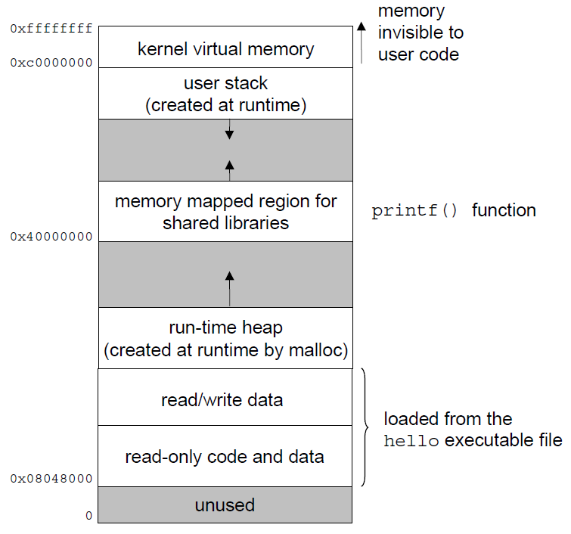

Slide 47
Move Instructions
Format
  mov src, dest
  src and dest can only be one of the following
    Immediate
    Register
    Memory

Slide 48
Move Instructions
Format
  The only possible combinations of the (src, dest) are
    (immediate, register)
    (memory, register) load
    (register, register)
    (immediate, memory) store
    (register, memory) store

Slide 49
Data Movement
Instruction | Effect | Description
movl S, D | D ← S | Move double word
movw S, D | D ← S | Move word
movb S, D | D ← S | Move byte
movsbl S, D | D ← SignedExtend( S) | Move sign-extended byte
movzbl S, D | D ← ZeroExtend(S) | Move zero-extended byte
pushl S | R[%esp] ← R[%esp]-4 M[R[%esp]] ← S | Push
popl D | D ← M[R[%esp]] R[%esp] ← R[%esp]+4 | Pop

Slide 50
Data Movement Example
movl $0x4050, %eax immediate register
movl %ebp, %esp register register
movl (%edx, %ecx), %eax memory register
movl $-17, (%esp) immediate memory
movl %eax, -12(%ebp) register memory

Slide 51
Data Formats
Move data instruction
  mov (general)
  movb (move byte)
  movw (move word)
  movl (move double word)

Slide 52
Different Mov Instructions
%ebp
-8
-12
int main(void){
char c = 1; short s = 2;
int i = 4; long l = 4L;
long long ll = 8LL;
return;
}
-16
-20
-24
-26
-27
8048335:c6 45 e5 01 movb $0x1,0xffffffe5(%ebp)
8048339:66 c7 45 e6 02 00 movw $0x2,0xffffffe6(%ebp)
804833f:c7 45 e8 04 00 00 00 movl $0x4,0xffffffe8(%ebp)
8048346:c7 45 ec 04 00 00 00 movl $0x4,0xffffffec(%ebp)
804834d:c7 45 f0 08 00 00 00 movl $0x8,0xfffffff0(%ebp)
8048354:c7 45 f4 00 00 00 00 movl $0x0,0xfffffff4(%ebp)

Slide 53
Data Movement Example
Initial value %dh=8d %eax =98765432
movb %dh, %al %eax=9876548d
movsbl %dh, %eax %eax=ffffff8d
3 movzbl %dh, %eax %eax=0000008d

Slide 54
Stack operation
Stack is a special kind of data structure
  It can store objects of the same type
The top of the stack must be explicitly specified
  It is denoted as top
There are two operations on the stack
  push and pop
There is a hardware stack in x86
  its bottom has high address number
  its top is indicated by %esp

Slide 55
Stack Layout
0xffffffff
memory invisible to
user code
kernel virtual memory
0xc0000000
Stack
Downward growth
%esp
Read/write data
Linux/x86 process
memory image
Read only data
Read only code
%eip
0x08048000
forbidden

Slide 56
Stack operation
There are two stack operation instructions
  Push and Pop
Push
  decreases the %esp (enlarge the stack)
  stores the value in a register into the stack
Pop
  stores the value in the top of the stack into a register
  increases the %esp (shrink the stack)

Slide 57
Stack Operation
Instruction | Effect | Description
pushl S | R[%esp] ← R[%esp]-4 M[R[%esp]] ← S | Push
popl D | D ← M[R[%esp]] R[%esp] ← R[%esp]+4 | Pop

Slide 58
Stack operations
%eax | 0x123
%edx | 0
%esp | 0x108
Increasing
address
pushl %eax ?
%esp
0x108
Stack “top”

Slide 59
Stack operations
%eax | 0x123
%edx | 0
%esp | 0x104
0x123
pushl %eax
popl %edx ?
0x108
%esp
0x104
Stack “top”

Slide 60
Stack operations
%eax | 0x123
%edx | 0x123
%esp | 0x108
0x123
popl %edx
%esp
0x108
0x104
Stack “top”

